Slide 1
Machine Language
Elements of Computing Systems, Nisan & Schocken, MIT Press www.idc.ac.il/tecs
Usage and Copyright Notice:
Copyright 2005 © Noam Nisan and Shimon Schocken
This presentation contains lecture materials that accompany the textbook “The Elements of Computing Systems” by Noam Nisan & Shimon Schocken, MIT Press, 2005.
We provide both PPT and PDF versions.
The book web site, www.idc.ac.il/tecs , features 13 such presentations, one for each book chapter. Each presentation is designed to support about 3 hours of classroom or self-study instruction.
You are welcome to use or edit this presentation as you see fit for instructional and non-commercial purposes.
If you use our materials, we will appreciate it if you will include in them a reference to the book’s web site.
If you have any questions or comments, you can reach us at tecs.ta@gmail.com

Slide 2
Where we are at:
Human
Abstract design
Software
Thought
abstract interface
hierarchy
Chapters 9, 12
H.L. Language
Compiler
&
abstract interface
Operating Sys.
Chapters 10 - 11
Virtual
VM Translator
Machine
abstract interface
Chapters 7 - 8
Assembly
Language
Assembler
Chapter 6
abstract interface
Computer
Machine
Architecture
Language
abstract interface
Chapters 4 - 5
Gate Logic
Hardware
abstract interface
Platform
Chapters 1 - 3
Electrical
Hardware
Chips &
Engineering
Logic Gates
Physics
hierarchy

Slide 3
Machine language is “the soul of the machine”
Duality:
Machine language ( = instruction set) can be viewed as an abstract (programmer-oriented) description of the hardware platform
The hardware can be viewed as a physical means for realizing an abstract machine language
Another duality:
Binary version
Symbolic version
Loose definition:
Machine language = an agreed upon formalism for manipulating
a memory using a processor and a set of registers
Same spirit but different syntax across different hardware platforms.

Slide 4
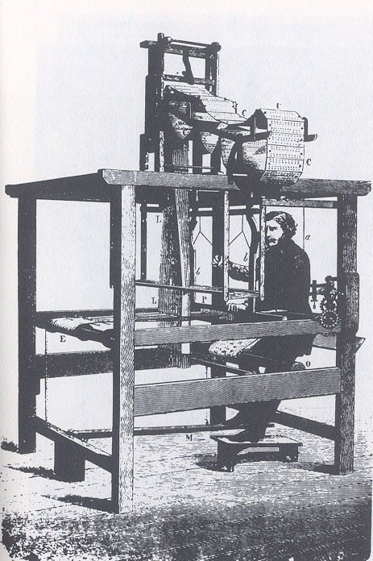

Binary and symbolic notation
1010 0001 0010 1011
ADD R1, R2, R3
Evolution:
Physical coding
Symbolic documentation
Symbolic coding
Translation and execution
Requires a translator.
Jacquard loom
(1801)
Augusta Ada King,
Countess of Lovelace
(1815-1852)

Slide 5
Lecture plan
Machine languages at a glance
The Hack machine language:
  Symbolic version
  Binary version
Perspective
(The assembler will be covered in lecture 6).

Slide 6
Instructions in a typical machine language
// In what follows R1,R2,R3 are registers, PC is program counter,
// and addr is a value.
ADD R1,R2,R3 // R1 ← R2 + R3
ADDI R1,R2,addr // R1 ← R2 + addr
AND R1,R1,R2 // R1 ← And(R1,R2) (bit-wise)
JMP addr // PC ← addr
JEQ R1,R1,addr // IF R1 = R2 THEN PC ← addr ELSE PC++
LOAD R1, addr // R1 ← RAM[addr] Where v is an address
STORE R1, addr // RAM[addr] ← R1 where v is an address
NOOP // Do nothings
// Plus several more commands that are essentially versions
// or extensions of the above commands.

Slide 7
The Hack computer
The 16-bit Hack computer consists of the following elements:
Data memory: RAM – a series of 16-bit words
Instruction memory: ROM – a series of 16-bit words
Registers: D, A, M, where M stands for RAM[A]
Processing: ALU, capable of computing various functions
Program counter: PC, holding an address
Control: The ROM is loaded with a sequence of 16-bit instructions, one per memory location, beginning at address 0. The next instruction is always fetched from ROM[PC]
Instruction set: Two instructions: A-instruction, C-instruction.

Slide 8
A-instruction
@value // A ← value
Where value is either a number or a symbol referring to some number.
Used for:
Entering a constant value
( A = value)
Coding example:
@17 // A = 17
D = A // D = 17
Selecting a RAM location
( register = RAM[A])
@17 // A = 17
D = M // D = RAM[17]
Later
Selecting a ROM location
( fetch ROM[A] )
@17 // A = 17
JMP // fetch the instruction
// stored in ROM[17]

Slide 9
Coding examples (programming practice)
Write the Hack instructions that
implement the following tasks:
Set A to 17
Set D to A-1
Set both A and D to A + 1
Set D to 19
Set both A and D to A + D
Set RAM[5034] to D - 1
Set RAM[53] to 171
Add 1 to RAM[7], and store the result in D.
Hack commands:
@value // set A to value
dest = x op y
op is + or -
x is A, D, or M
y is A, D, M or 1
(op y) is optional
dest is D , M , MD , A , AM , AD , AMD, or null

Slide 10
Coding examples (cont.)
Write the Hack instructions that
implement the following tasks:
Hack commands:
@value // set A to value
dest = x op y
op is + or -
x is A, D, or M
y is A, D, M or 1
(op y) is optional
dest is D , M , MD , A , AM , AD , AMD, or null
sum = 0
j = j + 1
q = sum + 12 – j
arr[7] = 0
Etc.
Symbol table:
j 17
sum 22
q 21
arr 16
(All symbols and values in are arbitrary examples)

Slide 11
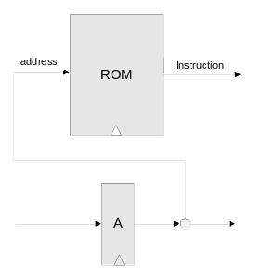
Control (first approximation)
ROM = instruction memory
Program = sequence of 16-bit
numbers, starting at
ROM[0]
Current instruction = ROM[A]
To select instruction n from the ROM, we set A to n, using the instruction @n
(The actual architecture is slightly different, as we’ll see in the next lecture)

Slide 12
Coding examples (practice)
Hack commands:
@value // set A to value
dest = comp ; jump // “dest = “ is optional
// Where:
comp = 0 , 1 , -1 , D , A , !D , !A , -D , -A , D+1 ,
A+1 , D-1, A-1 , D+A , D-A , A-D , D&A ,
D|A , M , !M , -M ,M+1, M-1 , D+M , D-M ,
M-D , D&M , D|M
dest = M , D , MD , A , AM , AD , AMD, or null
jump = JGT , JEQ , JGE , JLT , JNE , JLE , JMP, or null
All conditional jumps refer to the current value of D.
Write the Hack instructions that
implement the following tasks:
GOTO 50
IF D = 0 GOTO 112
IF D < 9 GOTO 507
IF RAM[12] > 0 GOTO 50
IF sum > 0 GOTO END
IF axis] <= 0 GOTO NEXT.
Symbol table:
sum 200
x 4000
i 151
END 50
NEXT 120
(All symbols and values in are arbitrary examples)

Slide 13
C-instruction syntax (final version)
dest = comp ; jump // comp is mandatory
// dest and jump are optional
Where:
comp is one of:
0,1,-1,D,A,!D,!A,-D,-A,D+1,A+1,D-1,A-1,D+A,D-A,A-D,D&A,D|A,
M, !M, -M, M+1, M-1,D+M,D-M,M-D,D&M,D|M
dest is one of:
null, M, D, MD, A, AM, AD, AMD
jump is one of:
null, JGT, JEQ, JGE, JLT, JNE, JLE, JMP

Slide 14
IF logic – Hack style
High level:
Hack:
if condition {
code segment 1}
else {
code segment 2}
// next instruction
D ← not condition)
@IF_TRUE
D;JEQ
code segment 2
@END
0;JMP
(IF_TRUE)
code segment 1
(END)
// next instruction
To prevent conflicting use of the A register, in well-written Hack programs a C-instruction that includes a jump directive should not contain a reference to M, and vice versa.

Slide 15
WHILE logic – Hack style
High level:
Hack:
while condition {
code segment 1
}
// next instruction
(LOOP)
D ← not condition)
@END
D;JEQ
code segment 1
@LOOP
0;JMP
(END)
// next instruction

Slide 16
Complete program example
C:
Hack:
// Adds 1+...+100.
into i = 1;
into sum = 0;
while (i <= 100){
sum += i;
i++;
}
// Adds 1+...+100.
@i // i refers to some memo. location
M=1 // i=1
@sum // sum refers to some memo. location
M=0 // sum=0
(LOOP)
@i
D=M // D = i
@100
D=D-A // D = i - 100
@END
D;JGT // If (i-100) > 0 got END
@i
D=M // D = i
@sum
M=D+M // sum += i
@i
M=M+1 // i++
@LOOP
0;JMP // Got LOOP
(END)
@END
0;JMP // Infinite loop
Demo
CPU emulator

Slide 17
Lecture plan
Symbolic machine language
Binary machine language

Slide 18
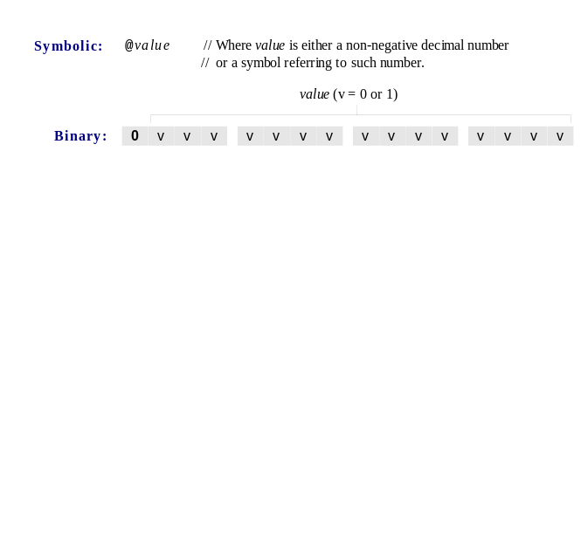
A-instruction

Slide 19
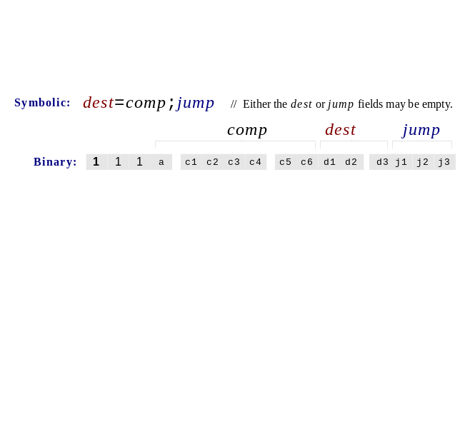
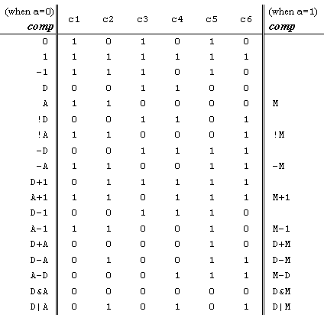
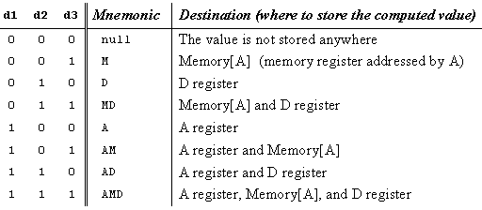
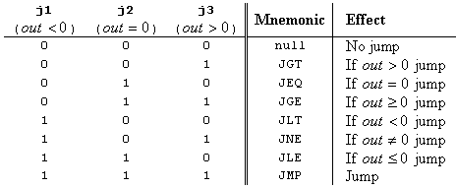
C-instruction

Slide 20
Symbols (user-defined)
// Recto program
@R0
D=M
@INFINITE_LOOP
D;JLE
@counter
M=D
@SCREEN
D=A
@addr
M=D
(LOOP)
@addr
A=M
M=-1
@addr
D=M
@32
D=D+A
@addr
M=D
@counter
MD=M-1
@LOOP
D;JGT
(INFINITE_LOOP)
@INFINITE_LOOP
0;JMP
Label symbols: User-defined symbols, used to label destinations of got commands. Declared by the pseudo command (XXX). This directive defines the symbol XXX to refer to the instruction memory location holding the next command in the program
Variable symbols: Any user-defined symbol xxx appearing in an assembly program that is not defined elsewhere using the “(xxx)“ directive is treated as a variable, and is assigned a unique memory address by the assembler, starting at RAM address 16
By convention, label symbols are upper-case and variable symbols are lower-case.

Slide 21
Symbols (pre-defined)
// Recto program
@R0
D=M
@INFINITE_LOOP
D;JLE
@counter
M=D
@SCREEN
D=A
@addr
M=D
(LOOP)
@addr
A=M
M=-1
@addr
D=M
@32
D=D+A
@addr
M=D
@counter
MD=M-1
@LOOP
D;JGT
(INFINITE_LOOP)
@INFINITE_LOOP
0;JMP
Virtual registers: R0,…, R15 are predefined
to be 0,…,15
I/O pointers: The symbols SCREEN and KBD are predefined to be 16384 and 24576, respectively (base addresses of the screen and keyboard memory maps)
Predefined pointers: the symbols
SP, LCL, ARG, THIS, and THAT
are predefined to be 0 to 4, respectively.

Slide 22
Perspective
Hack is a simple machine language
User friendly syntax: D=D+A instead of ADD D,D,A
Hack is a “½-address machine”
A Macro-language can be easily developed
A Hack assembler is needed and will be discusses and developed later in the course.

Slide 23
End-note: a macro machine language (can be implemented rather easily)
Assignment:
x = constant (e.g. x = 17)
x = y
x = 0 , x = 1, x = -1
Arithmetic / logical:
x = y op z
where y, z are variables or constants and
op is some ALU operation like +, -, and, or, etc.
Control:
GOTO s
IF condo THEN GOTO s
where condo is an expression (x op y) {=|<|>|…} {0|1}
e.g. IF x+17>0 got loop
White space or comments:
White space: ignore
// comment to the end of the line: ignore.

